Slide 1

Investments In Real Estate
Umar Sabir

Slide 2
Where should you invest?
Investment Strategy for my client
Low volatility and good returns
My goal
Find zip codes that fit my clients needs
Make predictions 4 years out

Slide 3
Tools and Dataset
Dataset from Zillow.com
Dataset details
Over 250 zip codes in the U.S
What makes up the zip code price?
Tools used
Python
Statsmodel SARIMA Model

Slide 4
How I chose Zip codes
Process of getting zip codes
Average volatility of the price per month of every zip code
Take zip codes that are less then that to get houses that have low volatility
Out of those calculate the average return per month
Lastly take the zip codes that have the most average return per month

Slide 5
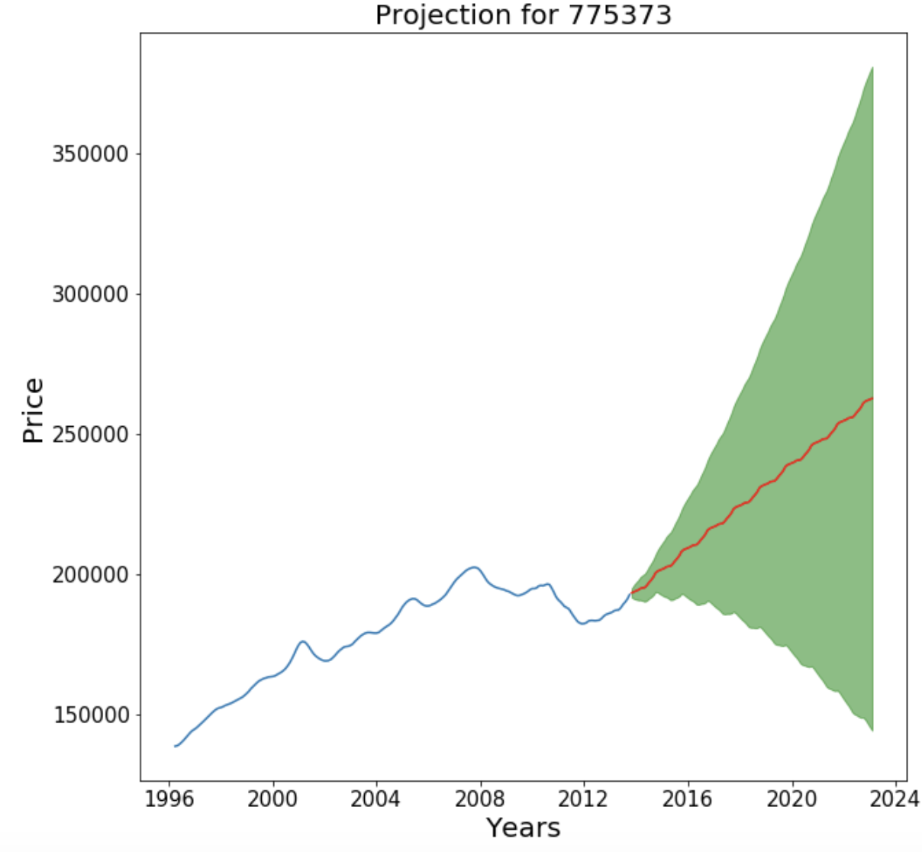
Zip code 93144
League City Texas
Price right now
$192600
Projected price 4 years
$262,655
Return on investment
36%

Slide 6
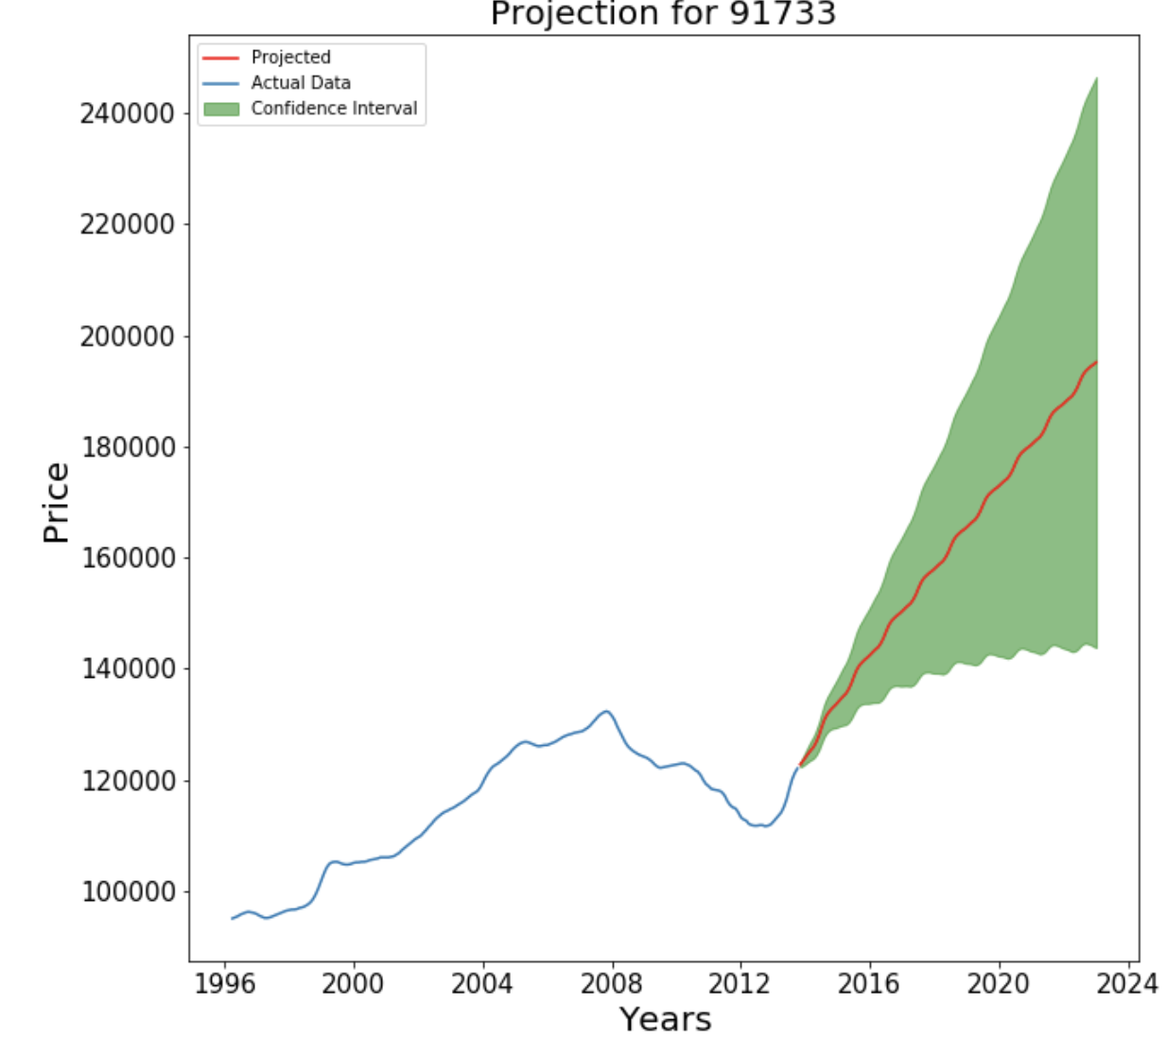
Zip code 91733
Houston Texas
Current price
$122,000
Projected price in 4 years
$199,513
Return on investment
60%

Slide 7
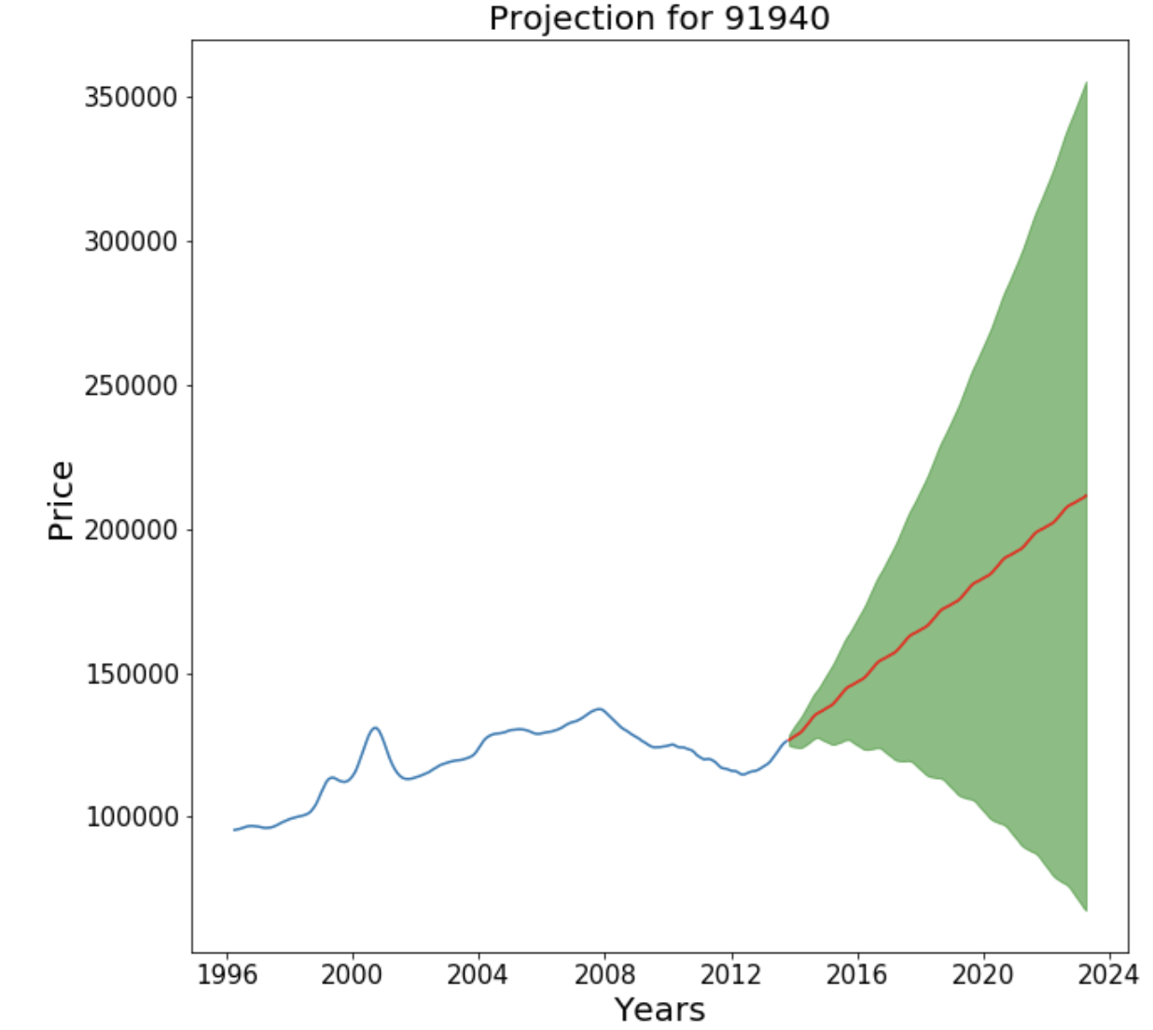
Zip code 91940
Houston Texas
Current price
$126,200
Predicted price in 4 years
$211,512
Return on investment
66%

Slide 8
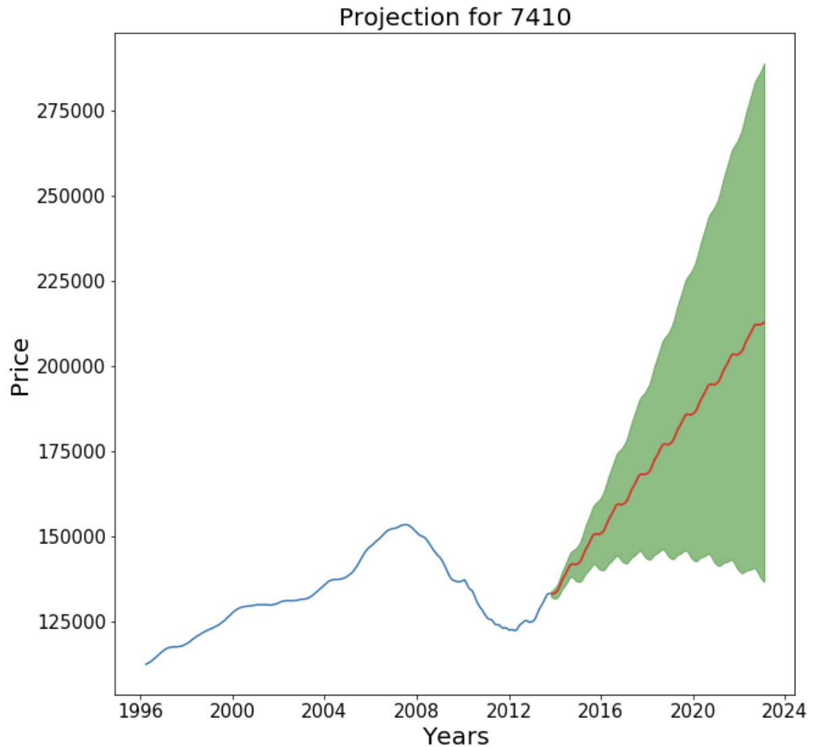
Zip Code 74101
Nashville Tennessee
Current price
$133,200
Predicted price in 4 years
$212,848
Return on Investment
%60

Slide 9
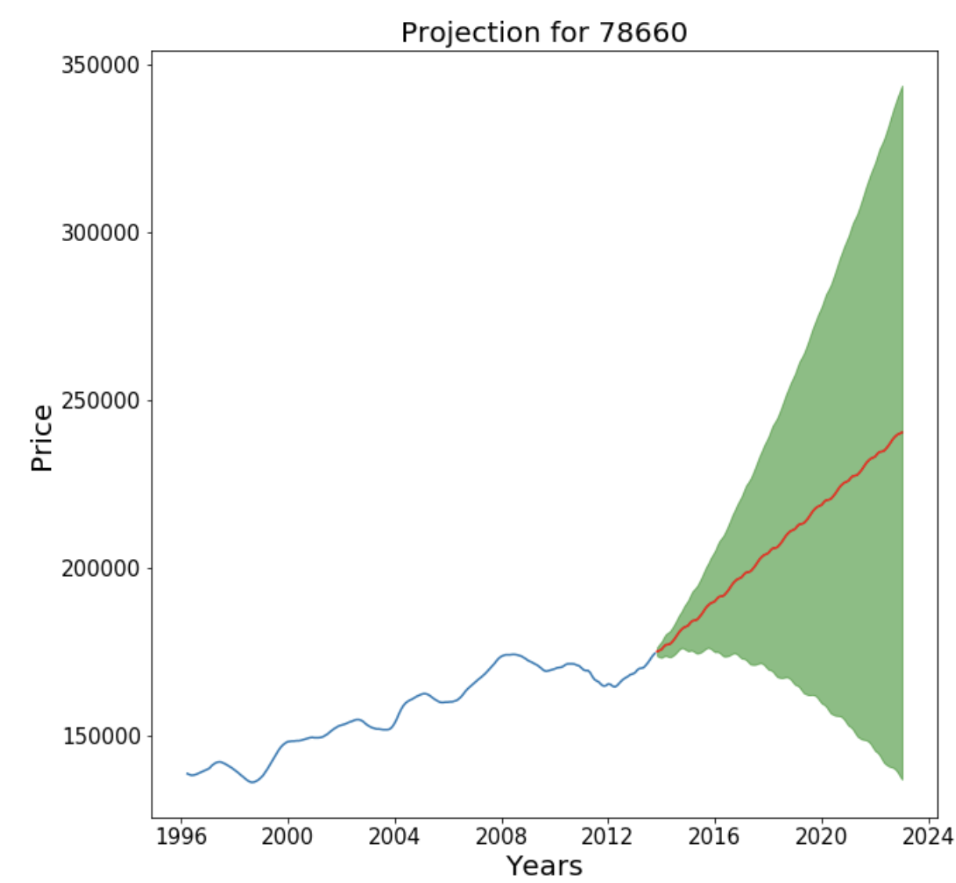
Zip Code 78660
Pfulugerville Texas
Current Price
$174,700
Projected price in 4 years
$240,506
Return on Investment
37%

Slide 10
What We learned
Zip codes
League City, Nashville, 2 in Houston, and El Paso
Predicted return on investment
50%

Slide 11
THANK YOU!! Sabiru7860@gmail.com

